Slide 1
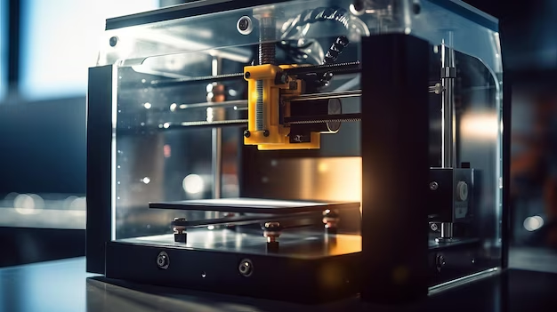

CAD CAM
AUTOMATED DEFECT DETECTION SYSTEM
Tejasvi Gharat - Third Year B.Tech Mechanical

Slide 2
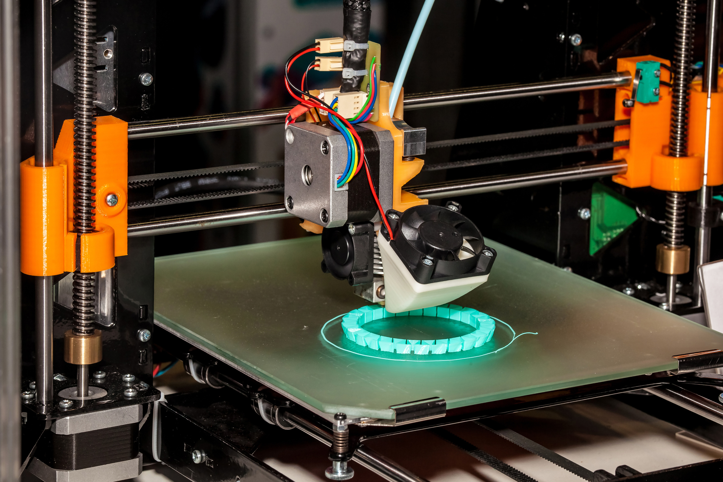

Introduction
Automated defect detection powered by AI is transforming manufacturing. By analyzing visual data, AI-based systems can quickly and accurately identify defects, enabling faster quality control and improved product yields

Slide 3

3D PRINTING
Additive manufacturing is a process of joining materials to 3D model data to make objects, which usually proceeds layer by layer
Printing defects
Overfill, underfill, surface roughness, and warping
Fused Deposition Modelling
A material extrusion technique in which a thermoplastic material is melted and extruded through the hot end to create printed layers

Slide 4
Challenges in Traditional Defect Detection Methods
Human Error
Slow Processes
Subjective Evaluations
Since traditional process optimization usually involves iterative experiments, the experimental process is both time-consuming and expensive An increasing number of research efforts are combining Machine learning with field monitoring.
Process data is monitored and recorded by placing sensors and cameras on the production site

Slide 5
PAST RESEARCH
Song used thermocouple sensors to record thermal timing data from a build platform and used the K-nearest neighbors (KNN) algorithm to predict the warping phenomenon in the FDM process. However, the classification accuracy was only 84% and was not compared with other related algorithms
. Westphal and Seitz used a transfer learning approach to experiment with image datasets in combination with an adaptive classifier for the analysis of the part manufacturing process The developed closed-loop system has 85% defect classification accuracy and can adjust the process parameters in time. However, the limited coverage of the microscope used to monitor the printing process in the experiment limits the identification of more other types of surface defects.

Slide 6
PAST RESEACH
Charalampous developed an ML method that is based on a regression algorithm to investigate the dimensional deviations of CAD models and solid parts.However, this analysis method only evaluates the measurement of printing results and ignores the mechanical movements and thermal changes inside the printed part during production
A laser-based online machining monitoring system was proposed by Lyu and Manoochehri .hey used a model called VGG16 to identify any anomalies happening within the layers They also used a method called PID online closed-loop controL.. However, the complex ML method resulted in relatively high computational costs and a long analysis time.

Slide 7
Petrich . developed a neural network that ingested multimodal sensor data from cameras, microphones, and machine logs to detect defects in laser powder bed fused AM parts with 99.9% accuracy .
In this presentation , defect classification method for FDM processes is proposed for defect diagnosis by fusing the prediction results of two machine learning models. By fusing vision- and sensingbased methods, the classification accuracy is significantly improved compared to the classification of defects in the FDM process using the two methods alone. The accuracy is about 97.9%

Slide 8


MATERIALS NEEDED

Slide 9


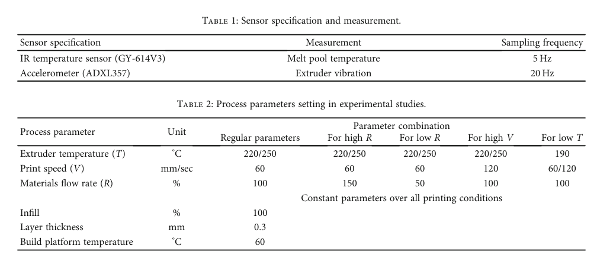
SENSOR, 3D PRINTER AND IMAGE RECORDER
3D PRINTER : ACCUCRAFT I250D
AOMEKIE USB MICROSOPE
IR SENSOR & ACCELEROMETER

Slide 10
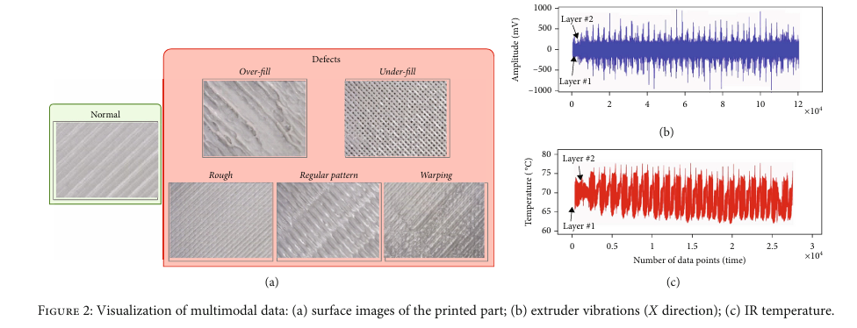

Slide 11
MACHINE LEARNING MODELS

Slide 12



We can use three machine learning algorithms from the three algorithms that we found with the help of research papers and books available online.
01
02
03
VISION BASED
DEFECT CLASSIFICATION
TIME SERIES DATA CLASSIFICATION
COMBINATION OF VISION AND SENSING

Slide 13
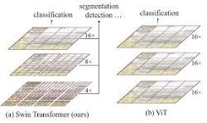
VISION BASED DEFECT CLASSIFICATION ALGORITHM
SWIN TRANSFORMER
USE OF A SW-MSA THAN MSA : W-MSA + SW-MSA
TRANSFER LEARNING
Thus, we use a swin transformer model at 224 X 224 resolution.
The loss function : SparseCategoricalCrossentropy
Adam Optimizer

Slide 14

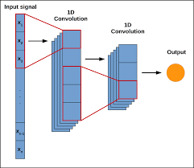
TIME SERIES DATA CLASSIFICATION ALGORITHM
1DCNN model to take care of extruder temperature and vibration during the FDM process.

Slide 15
COMBINATION OF VISION AND SENSING
Fuse both the method of vision based defect classification and time series data classification
STEPS
Pimg(v) = Pimg(1) Pimg(2).............Pimg(p)
Pimg,i represents the probability of the test vector v for the class of i and n is the total number of classes.
Psen(s) = Psen(1) Psen(2) ⋯, Psen(n) represents the class probability of the sensing signal feature vector based on the sensing signal classification prediction.
P = (P1,P1,⋯,Pn) = (Pimg,1 +kj ∗Psen,1, Pimg,2 + kj ∗Psen,2, ⋯, Pimg,n + kj ∗Psen,n)

Slide 16
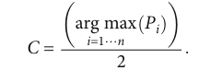
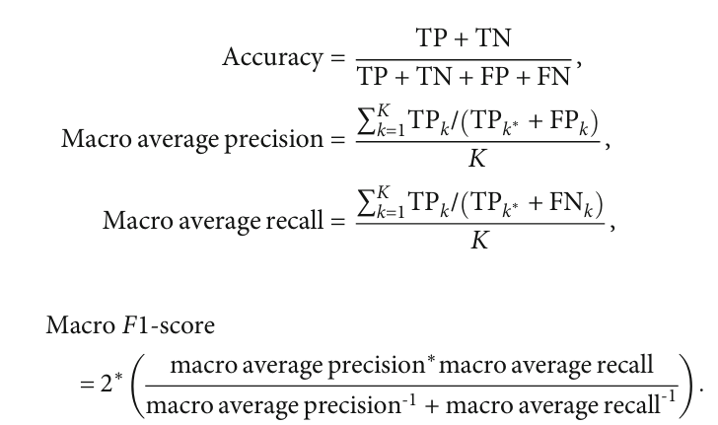
STEPS
Finally, the class label C predicted by fusion is given by the following equation :
Finally, the class label C predicted by fusion is given by the following equation :

Slide 17
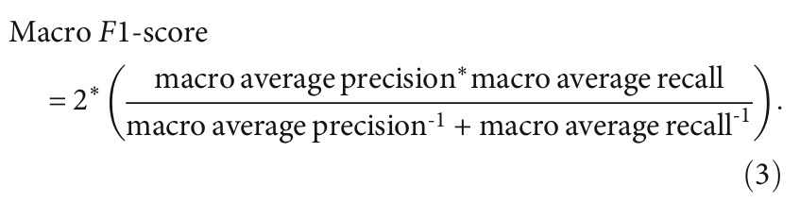

Slide 18

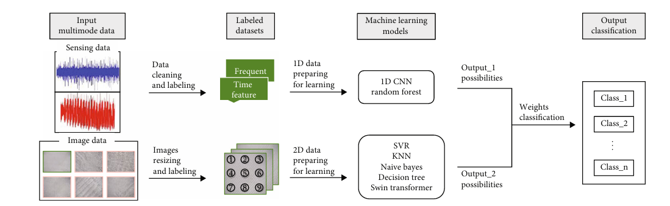
Project Timeline

Slide 19
RESULTS

Slide 20
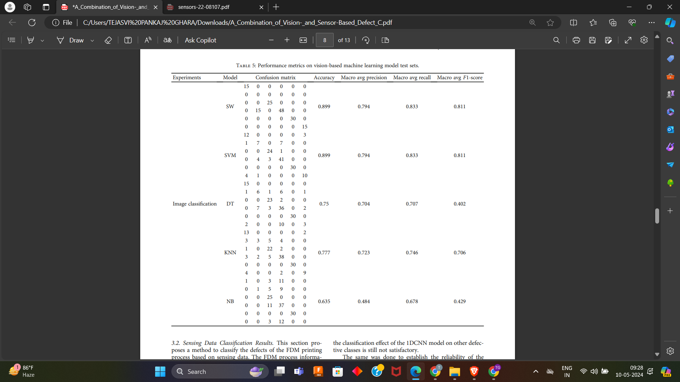
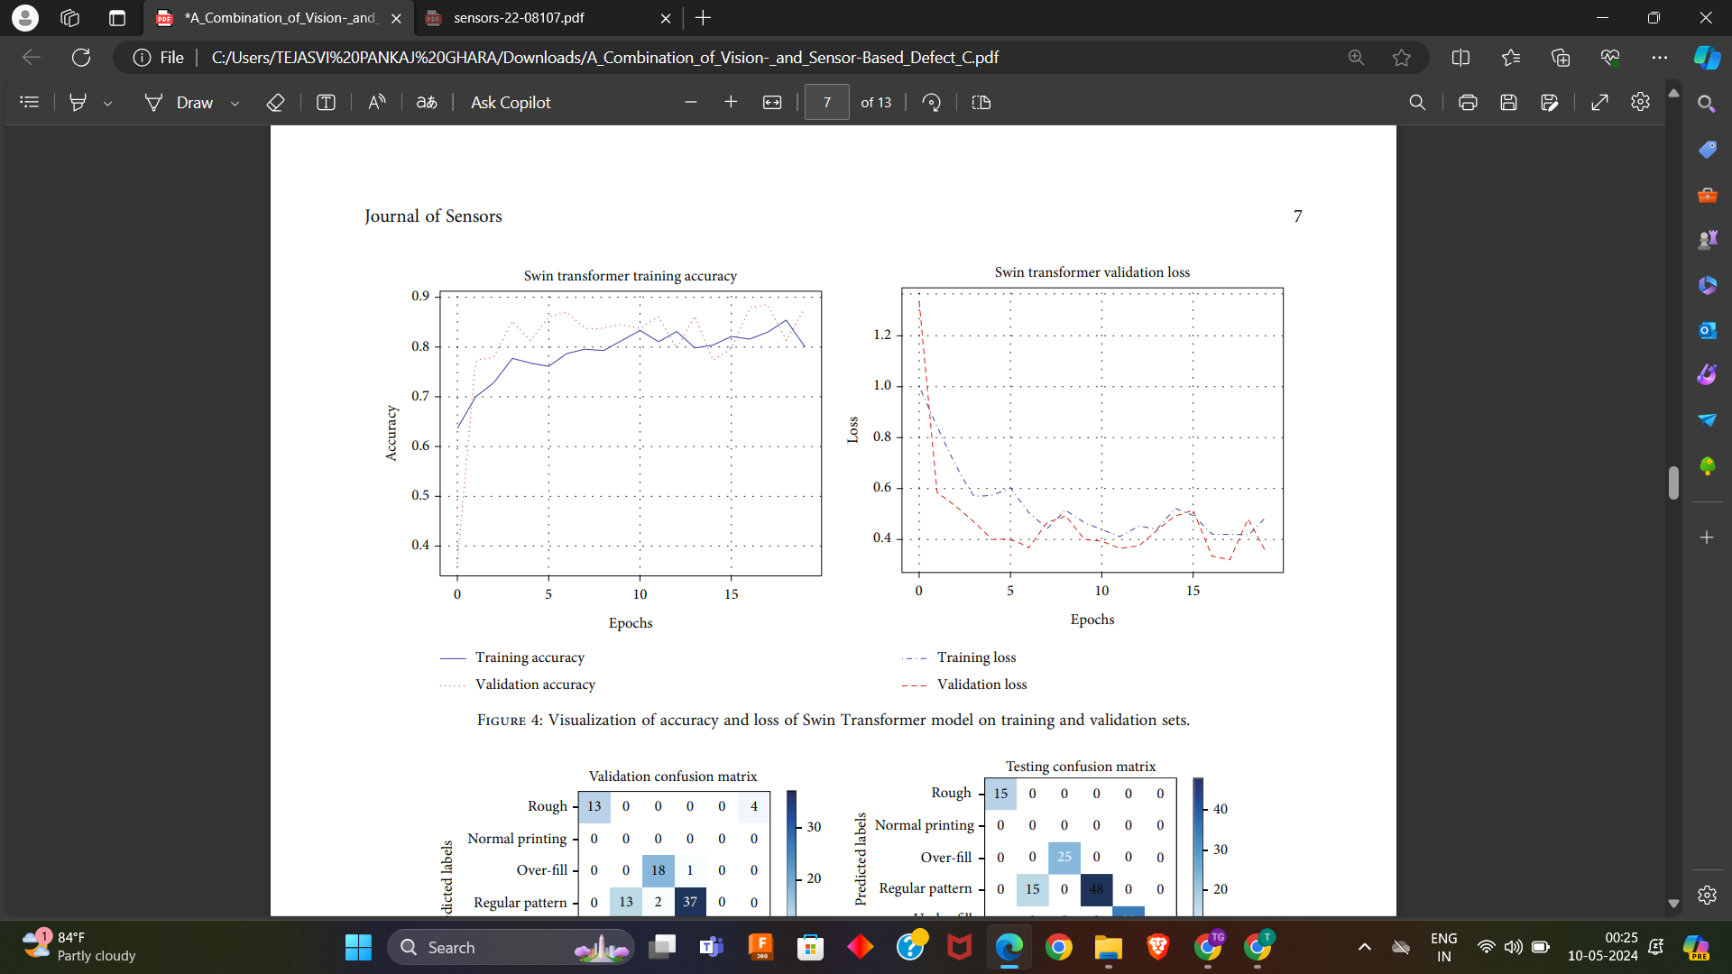
Image Classification Results.
Swin Transformer model

Slide 21
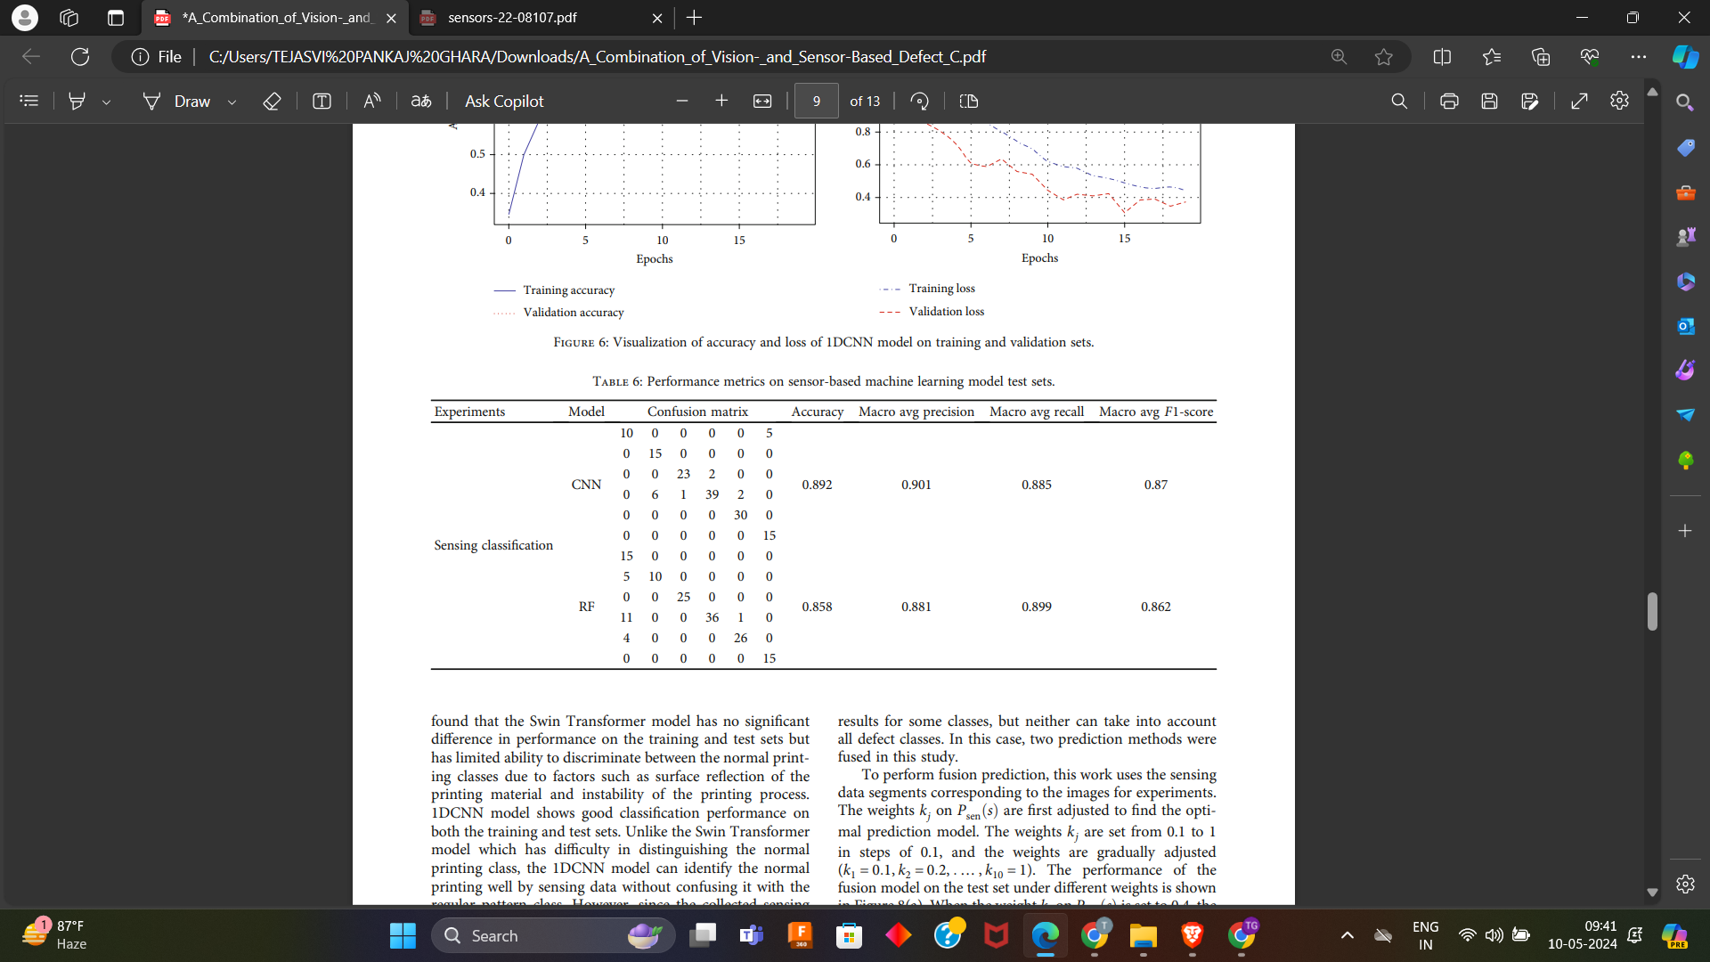
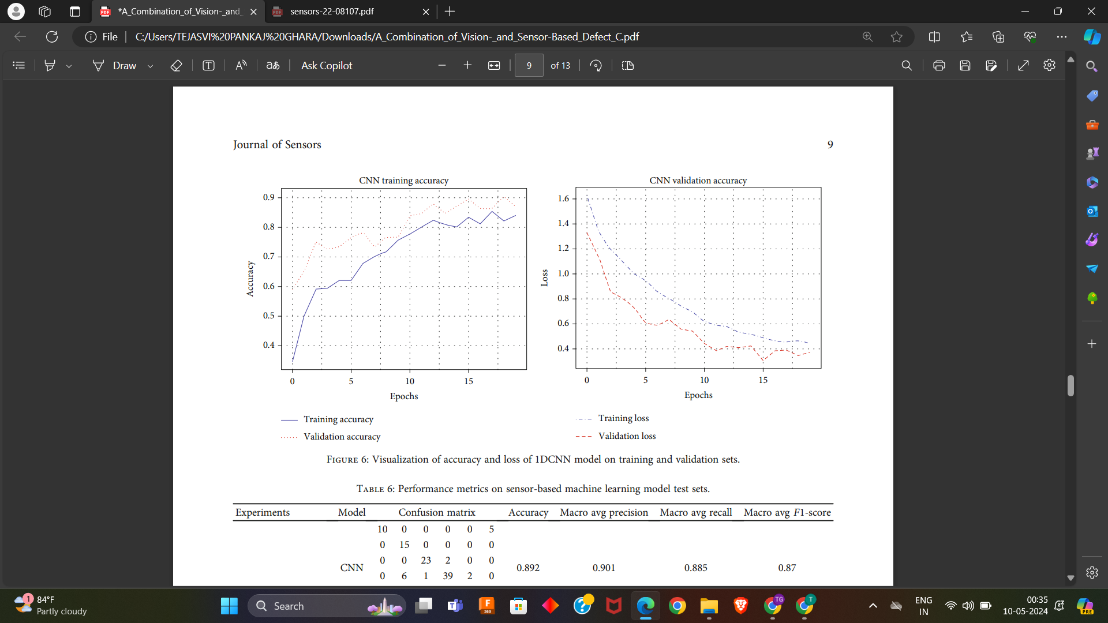
Sensing Data Classification Results.
1DCNN model

Slide 22
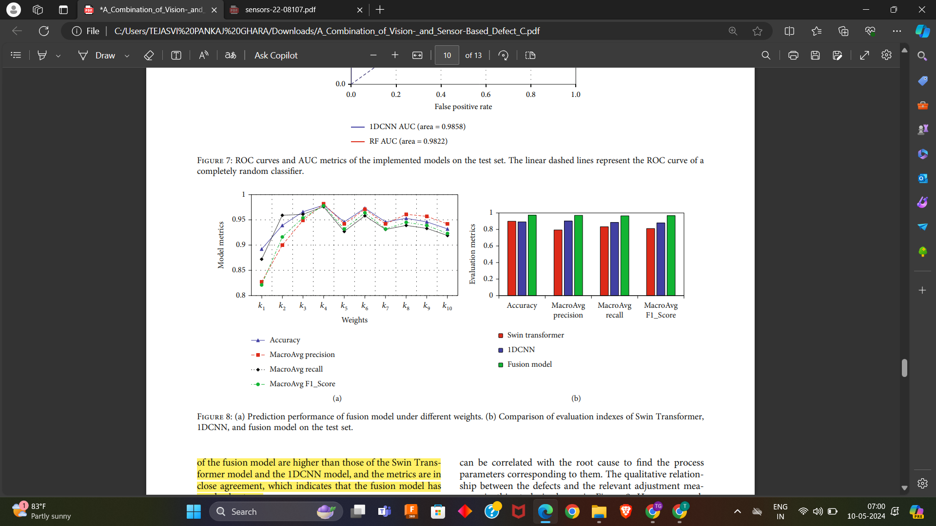
FUSION MODEL.
Prediction performance of fusion model under different weights.
Comparison of evaluation indexes of Swin Transformer,1DCNN, and fusion model on the test set.
Overall the evaluation metrics of the fusion model are higher than those of the Swin Trans?former model and the 1DCNN model, and the metrics are in close agreement, which indicates that the fusion model has good robustness

Slide 23

The fusion model successfully classified various surface defects in the printed parts into six types based on printing quality.
Rough
Warping
Regular Pattern
Over-Fill
Under-Fill

Slide 24
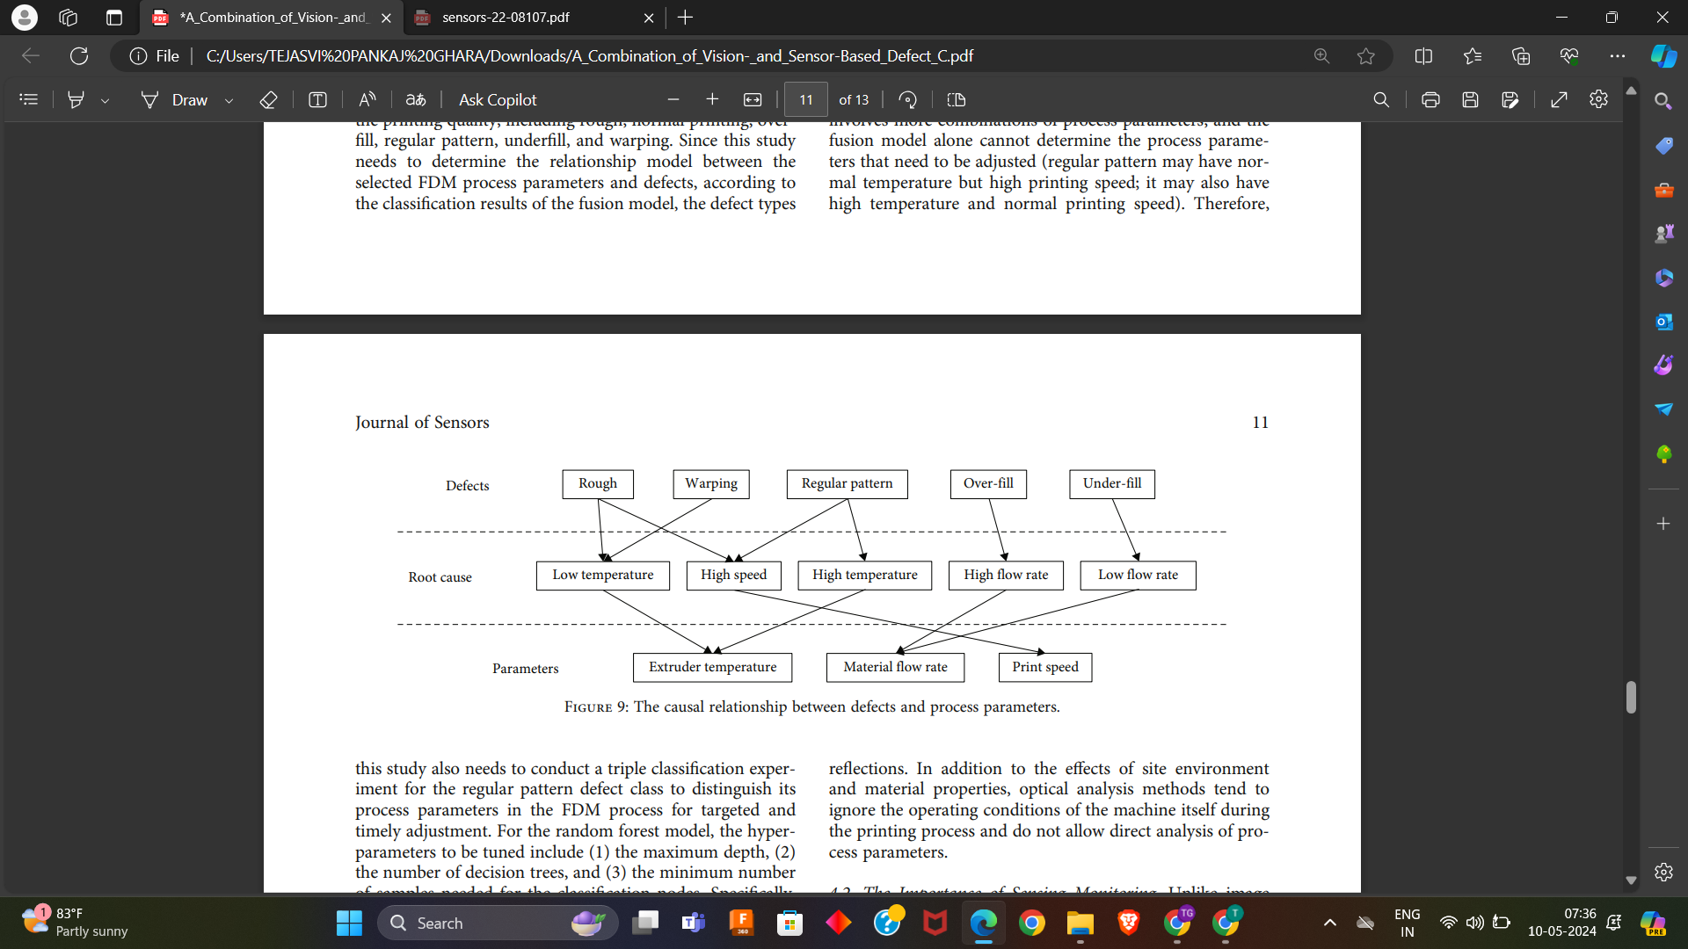
According to the classification results of the fusion model, the defect types can be correlated with the root cause to find the process parameters corresponding to them.

Slide 25
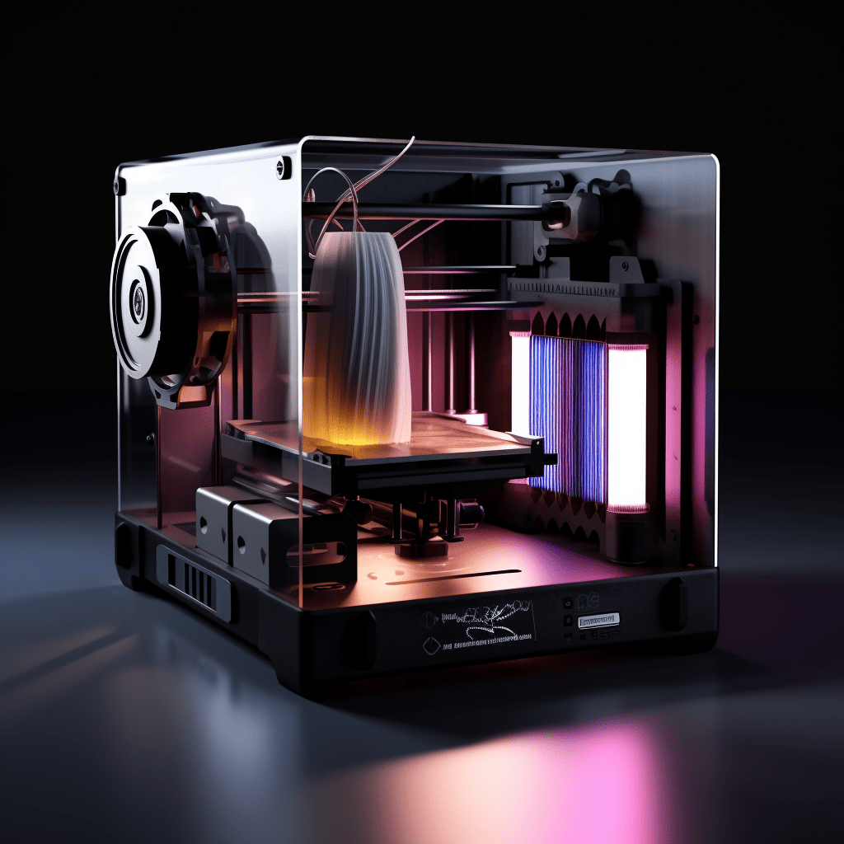
Conclusion
In this study, we proposed a method to improve defect detection in 3D printing. We combined vision-based and sensor-based techniques to diagnose printing issues.The fused model performed better, with over 8.9% and 9.8% higher accuracy compared to individual models. Overall, the experiments demonstrated that machine learning is a promising solution for detecting surface defects in 3D printing and adjusting printer settings accordingly.

Slide 26
References
Machine Vision-Based Scanning Strategy for Defect Detection in Post-Additive Manufacturing S. Zhang, Z. Chen, K. Granland, Y. Tang, and C. Chen
Detecting Malicious Defects in 3D Printing Process Using Machine Learning and Image Classification
A Combination of Vision- and Sensor-Based Defect Classifications in Extrusion-Based Additive Manufacturing Xiao-Yu Li , Fu-Long Liu, Meng-Na Zhang, Ming-Xia Zhou, Chuan Wu, and Xiao Zhang

